Slide 1


Slide 2
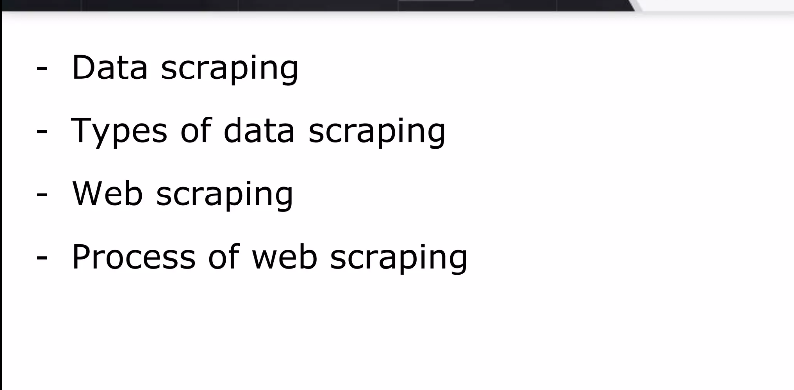

Slide 3
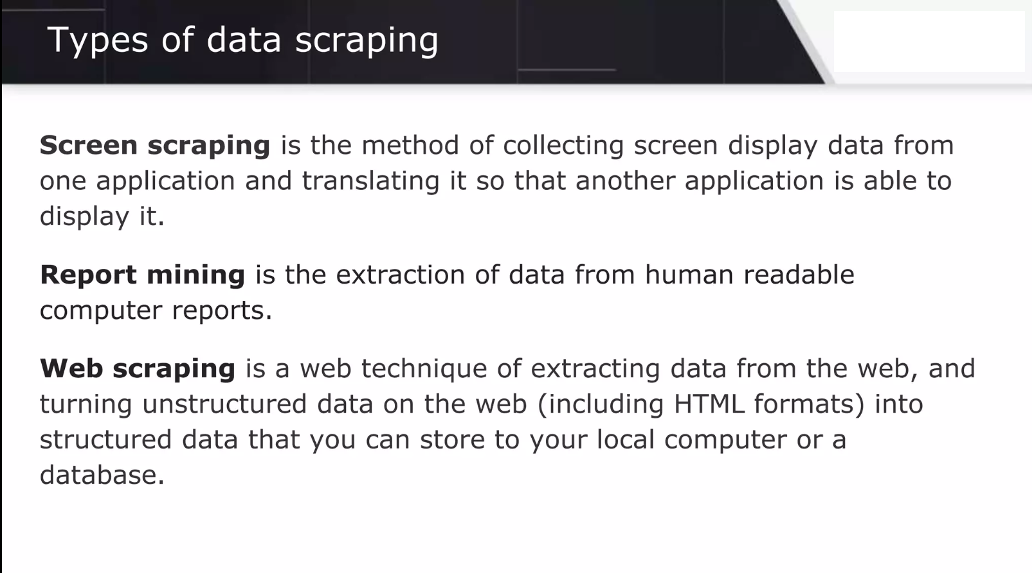

Slide 4
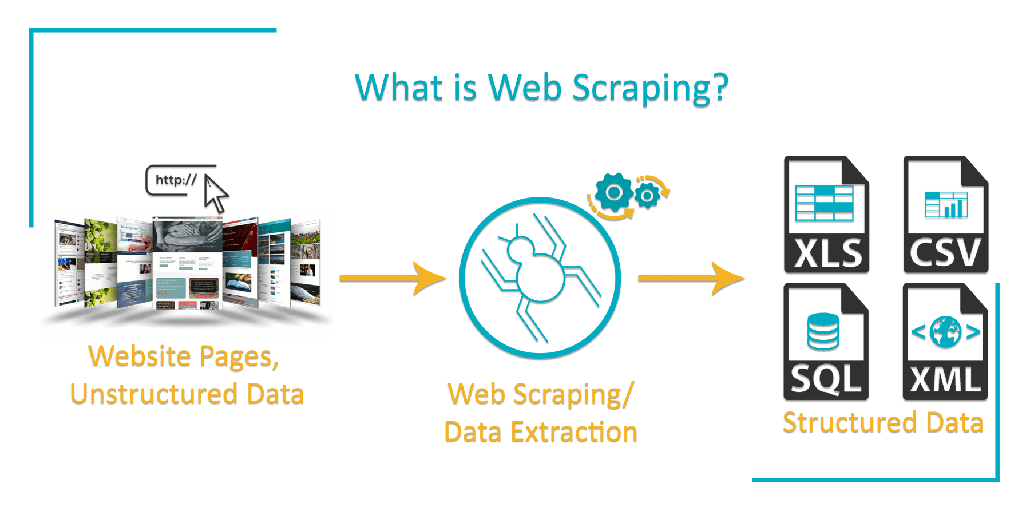

Slide 5
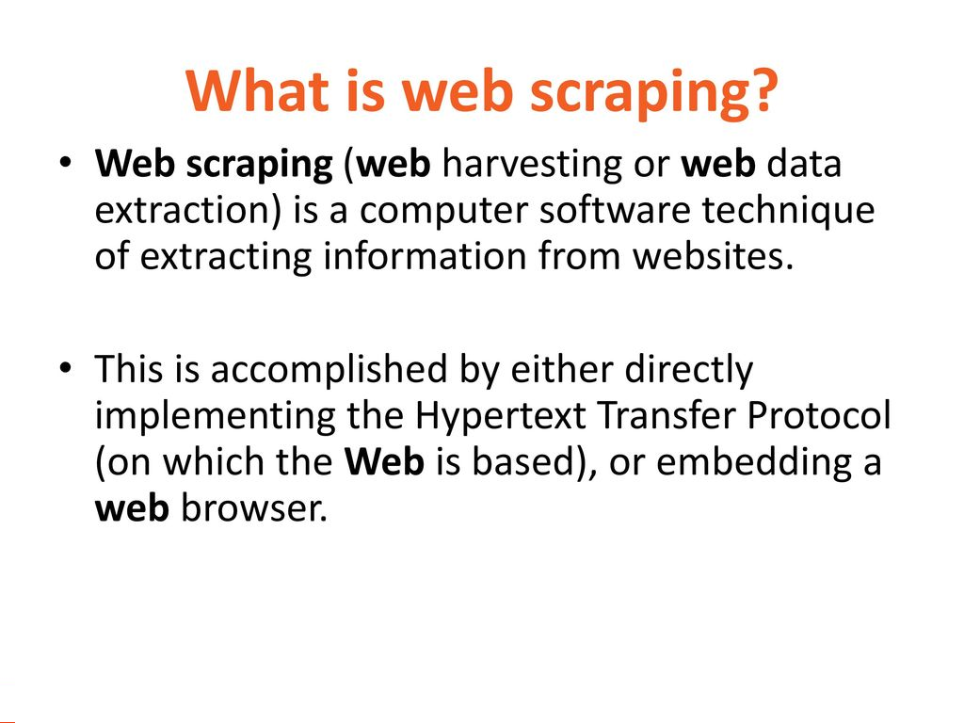

Slide 6
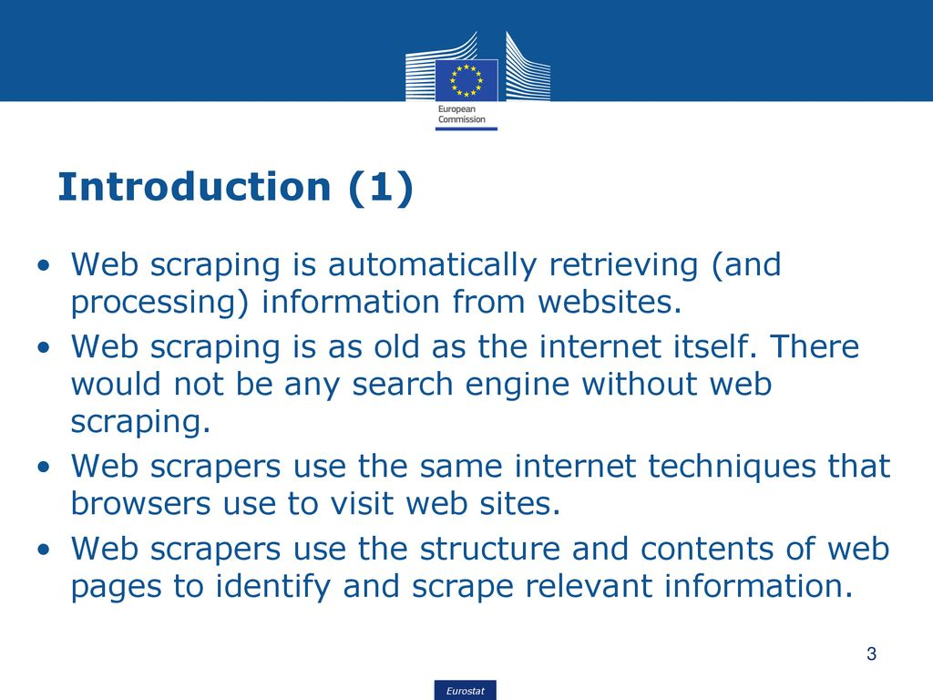

Slide 7
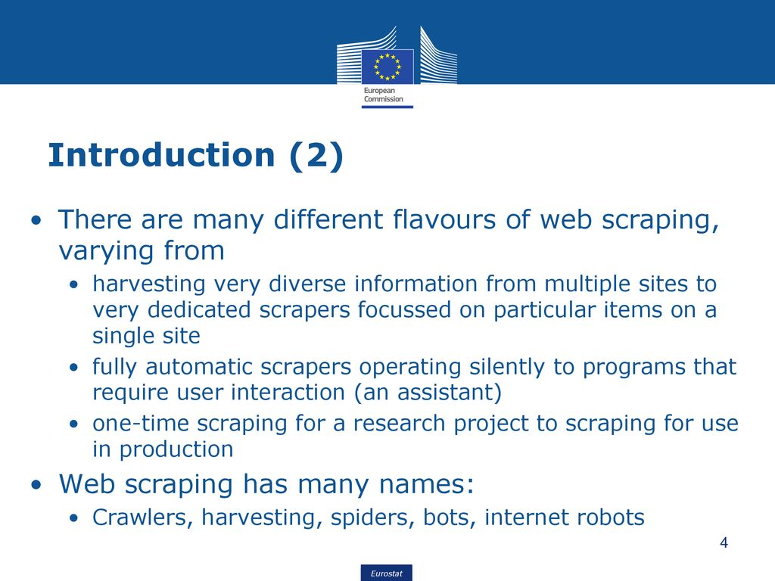

Slide 8
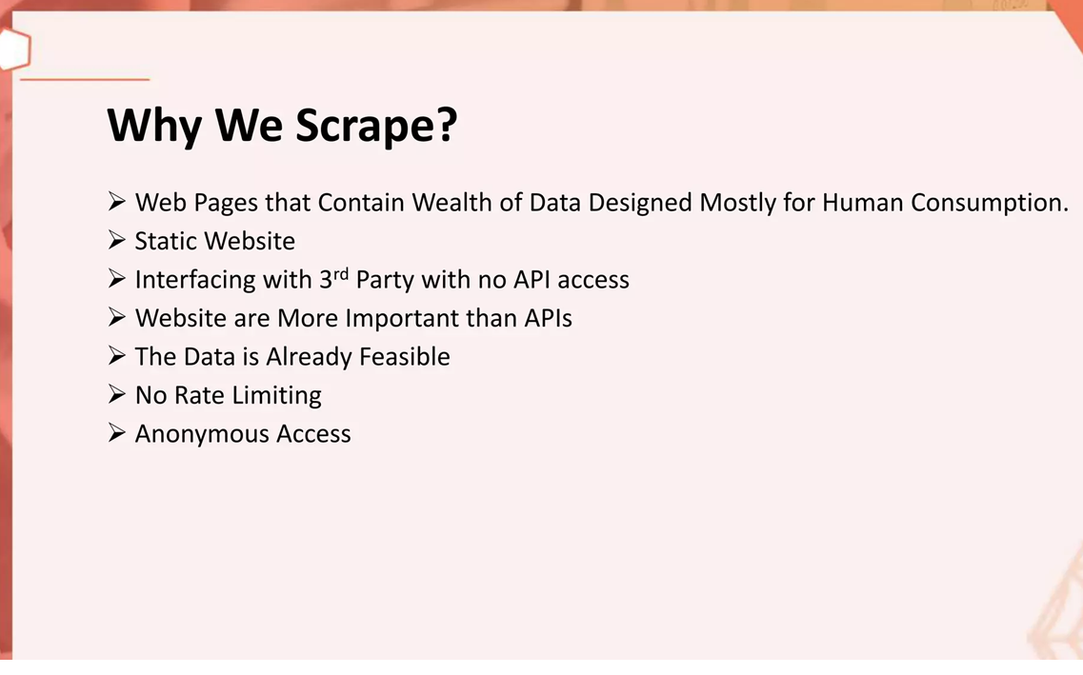

Slide 9
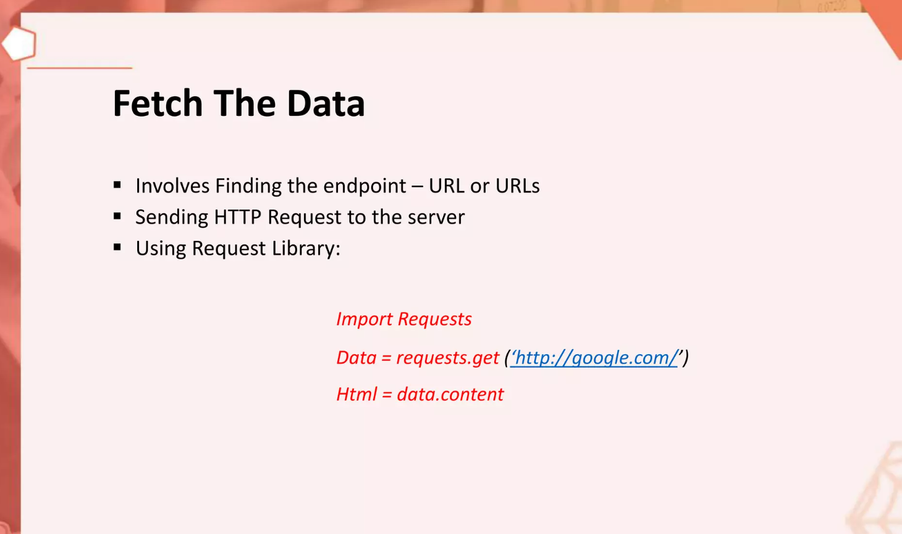

Slide 10
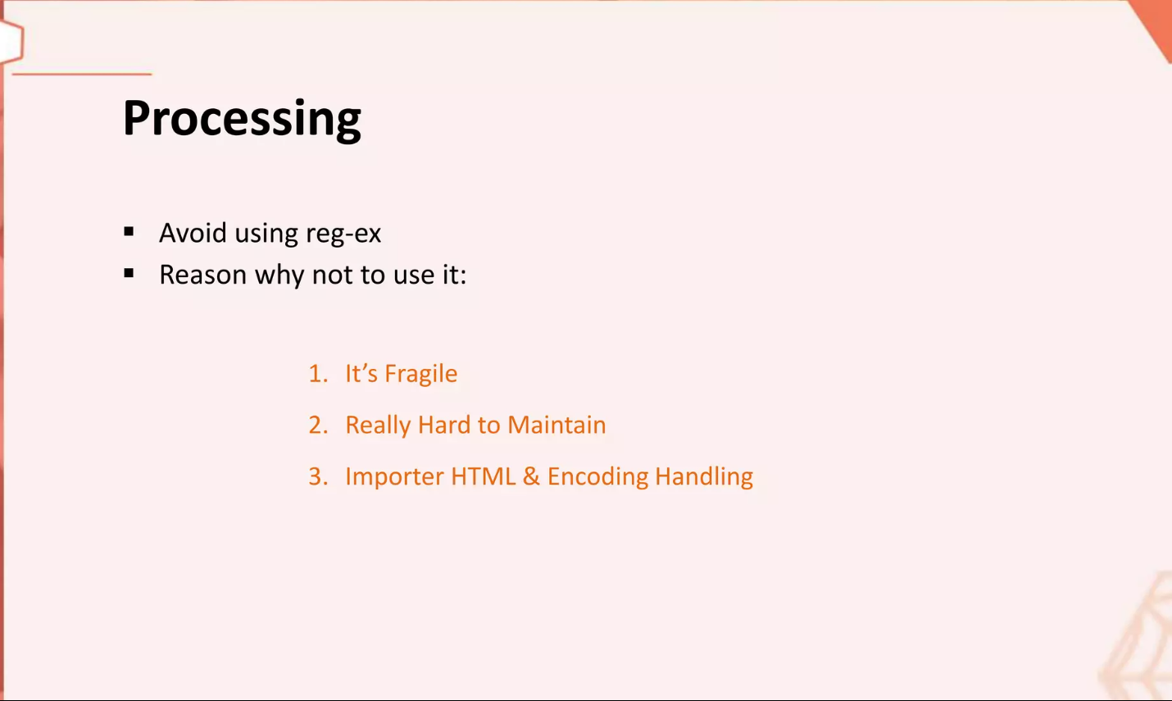

Slide 11


Slide 12
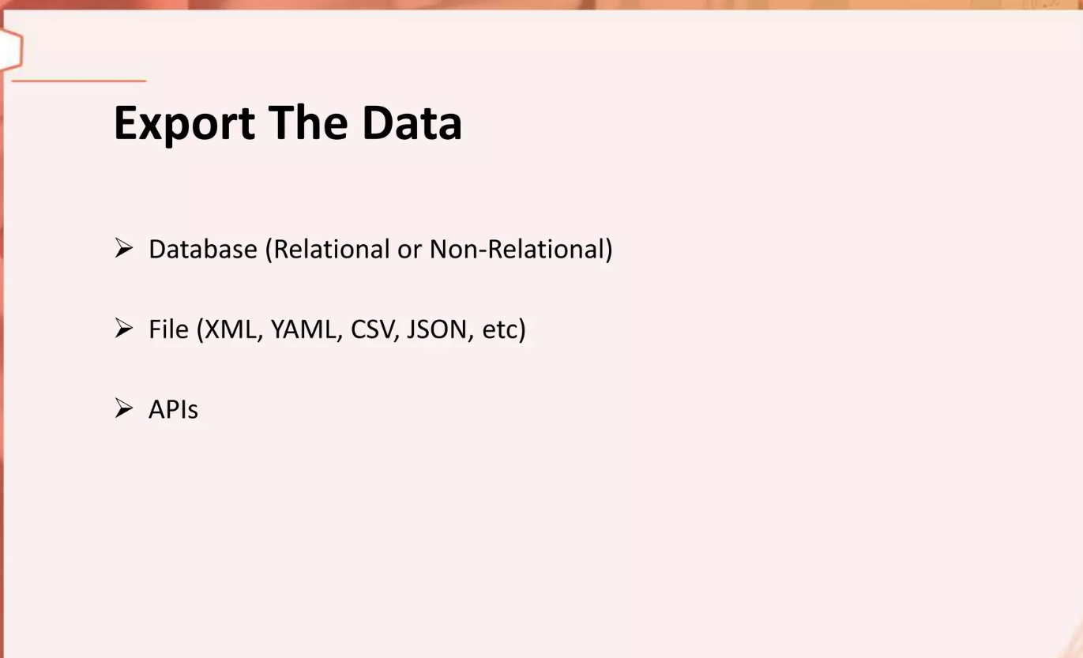

Slide 13
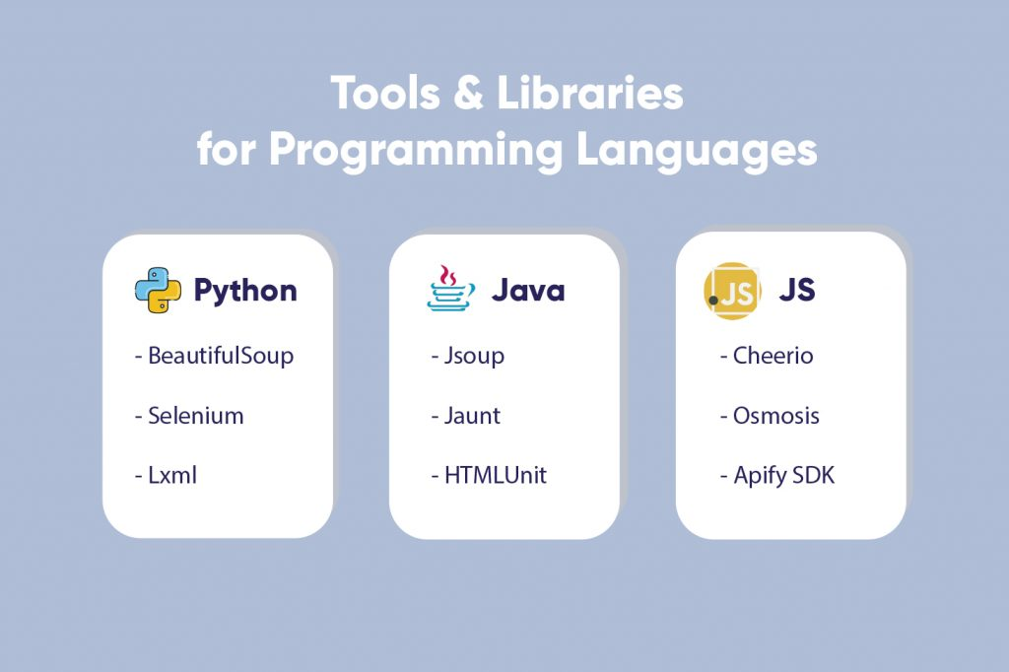

Slide 14
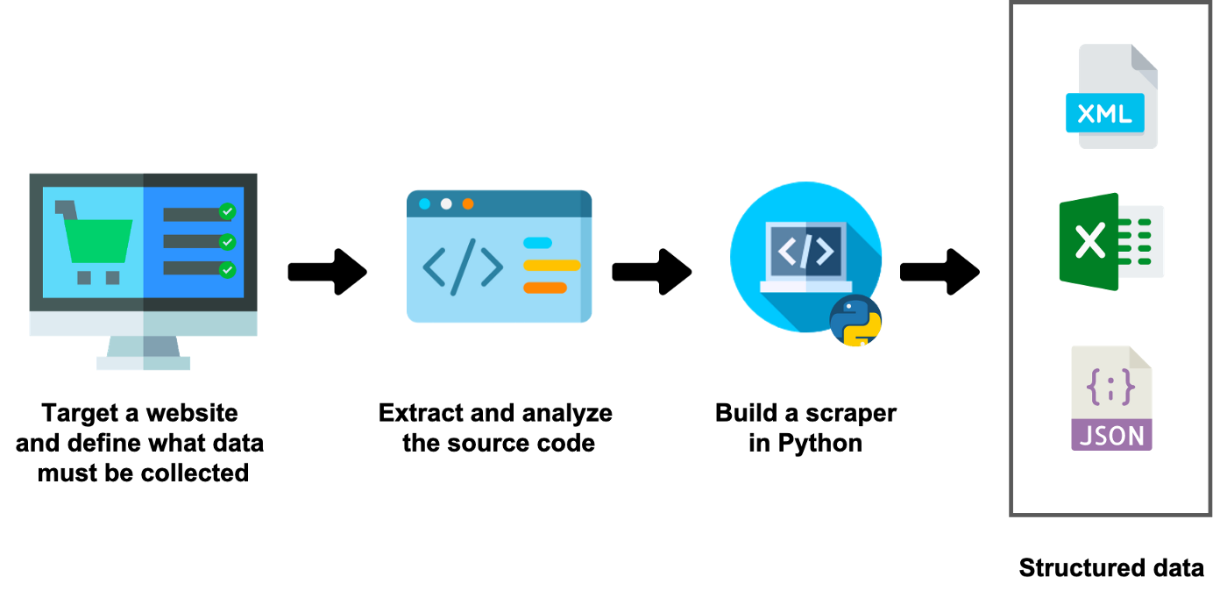

Slide 15
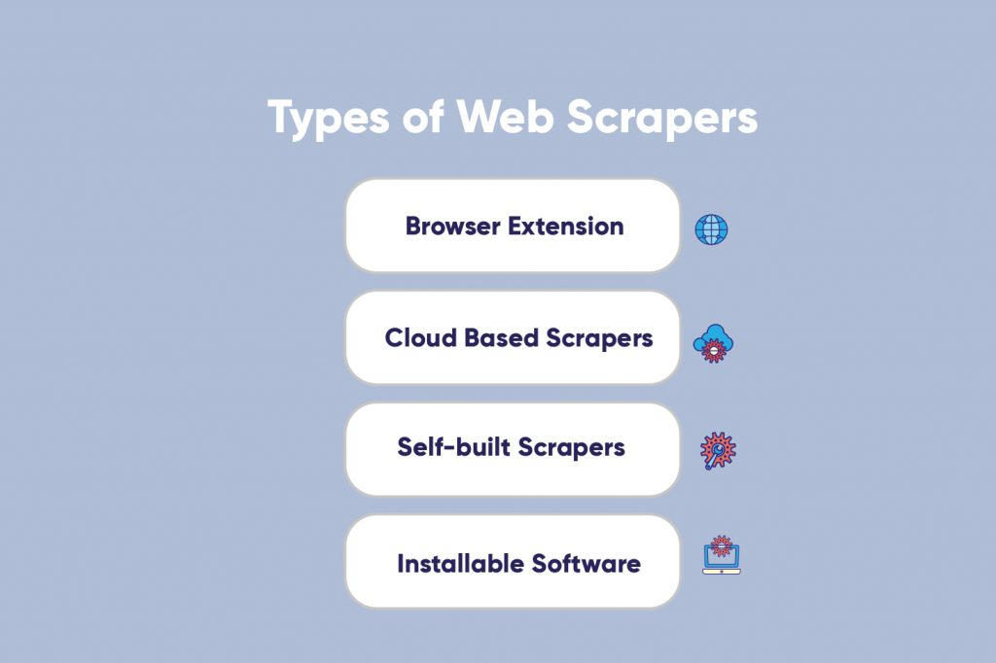

Slide 16
Scraping Github Top Repository
We're going to scrape https://github.com/topics
We'll get a list of topics. For each topic, we'll get topic title, topic page URL and topic description
For each topic, we'll get the top 25 repositories in the topic from the topic page.
For each repository, we'll grab the repo name, username, stars and repo URL.
For each topic we'll create a CSV file in the following format: ``` Repo Name,Username,Stars,Repo URL three.js,mrdoob,69700,https://github.com/mrdoob/three.js libgdx,libgdx,18300,https://github.com/libgdx/libgdx ```

Slide 17
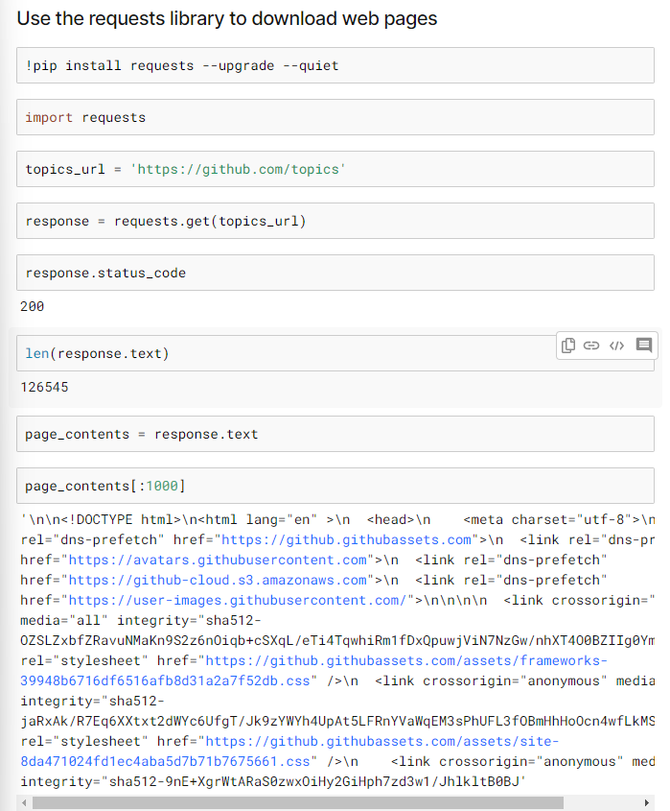

Slide 18
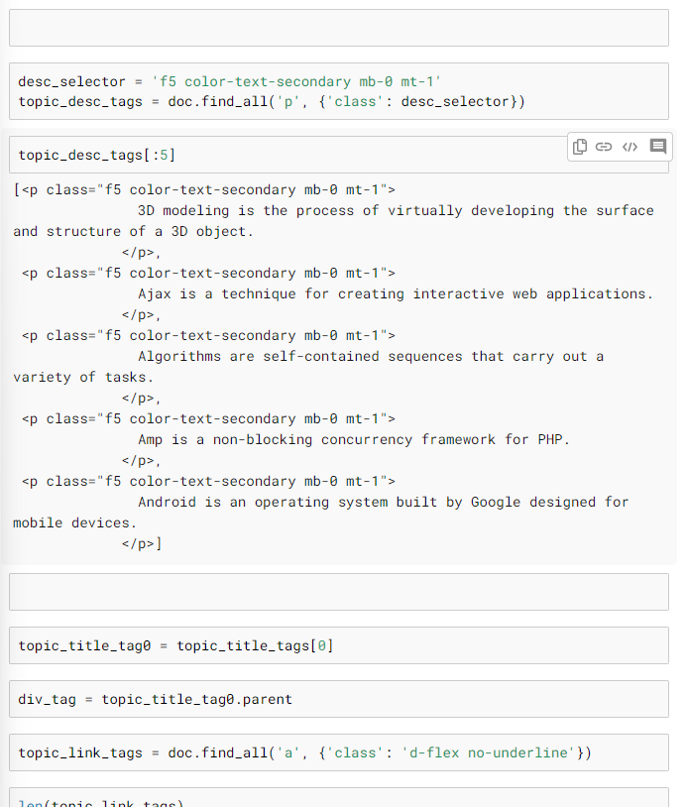

Slide 19
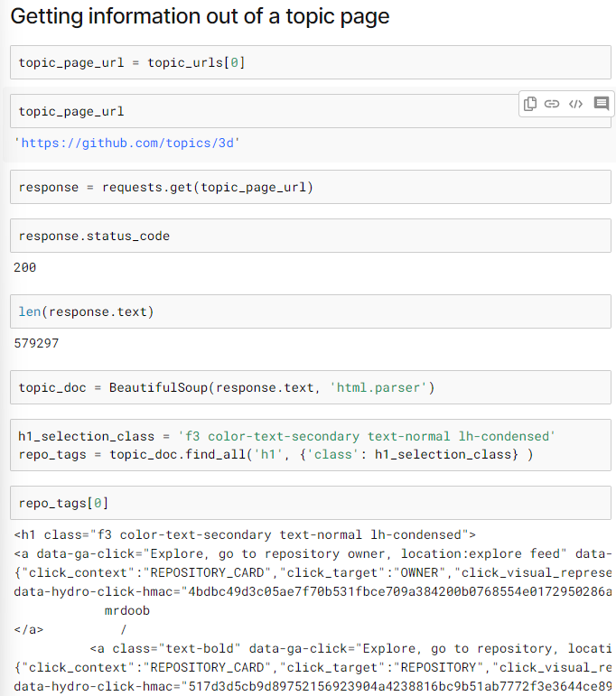

Slide 20
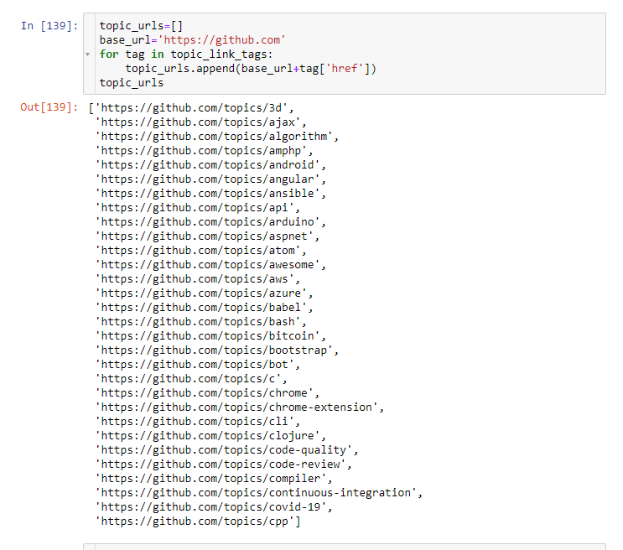

Slide 21
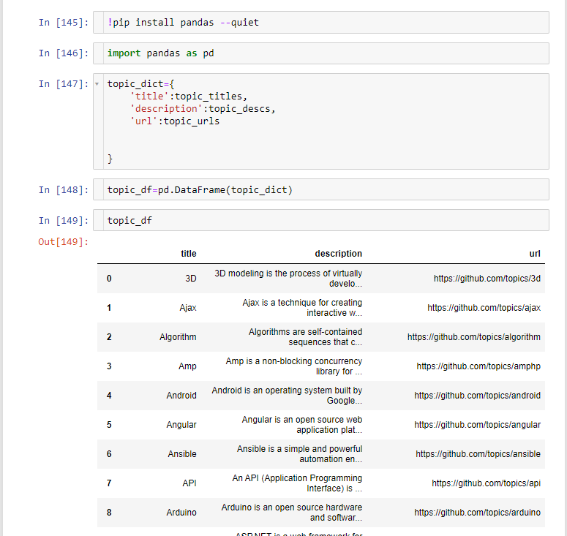

Slide 22
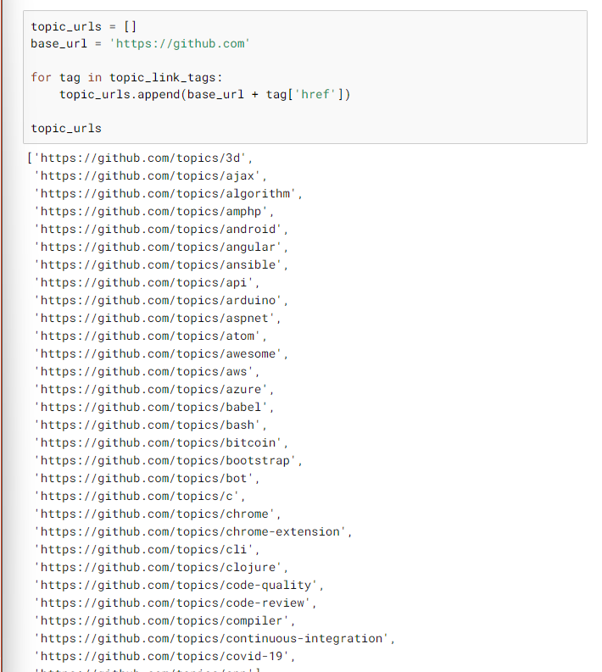

Slide 23
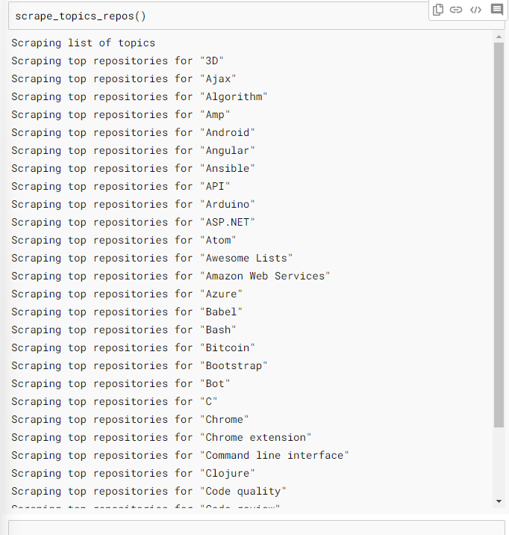

Slide 24
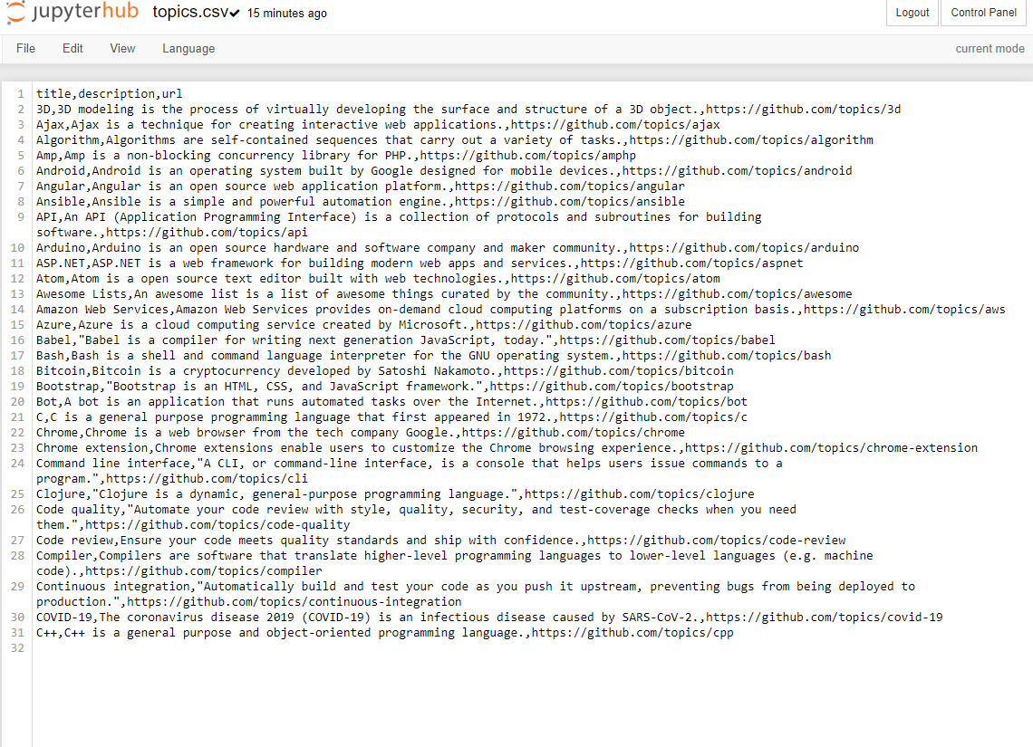

Slide 25
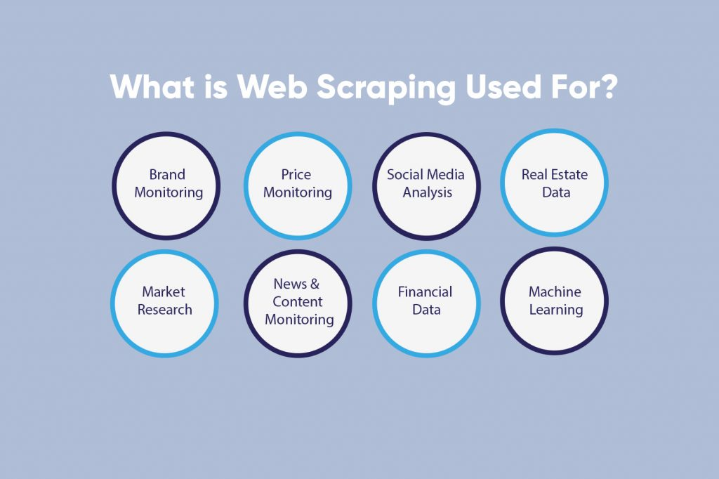

Slide 26
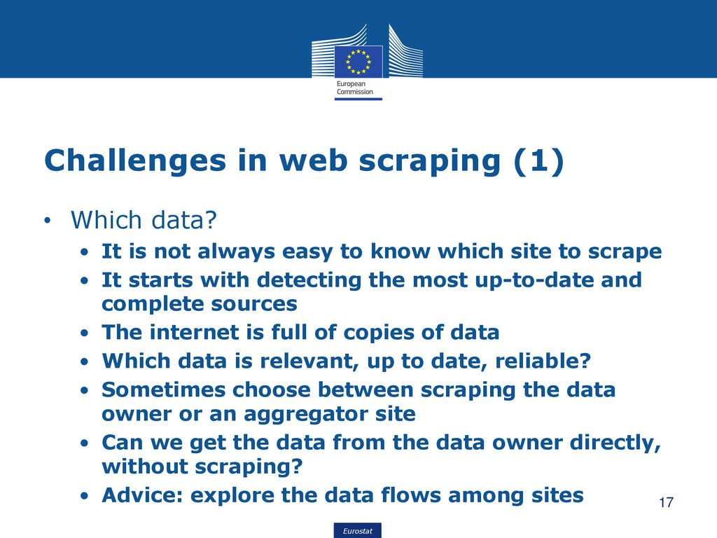

Slide 27
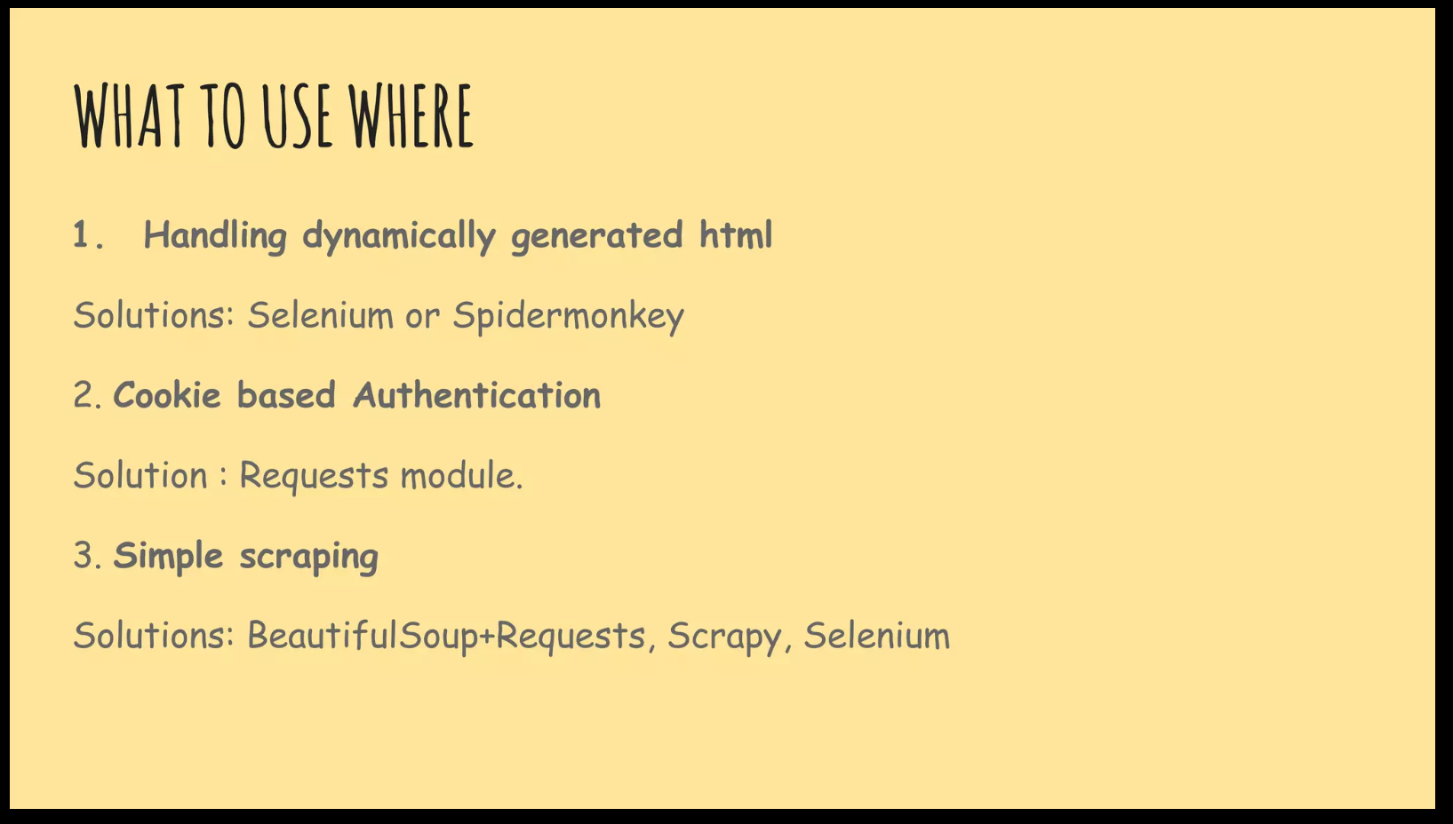

Slide 28
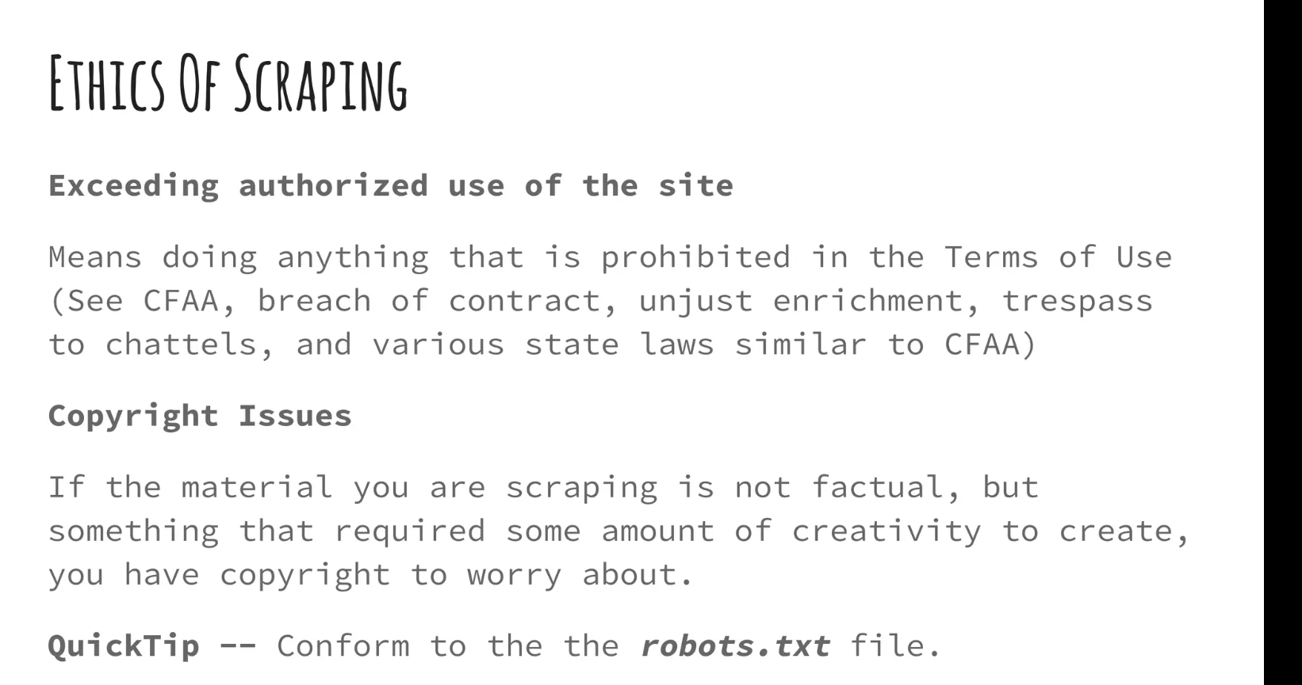

Slide 29


